Slide 1
California Water
Jeffrey Kightlinger, General Manager
The Metropolitan Water District of Southern California
11/16/2015 – Arizona Town Hall

Slide 2
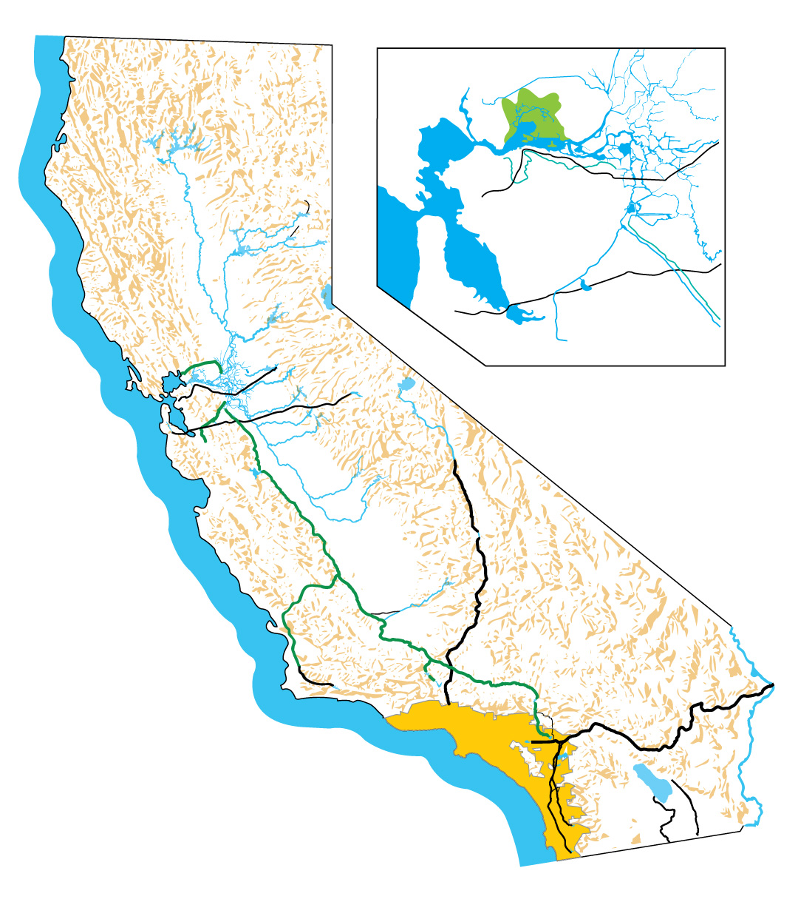
Metropolitan’s Service Area Diverse Water Supplies
Bay-Delta
Southern California Water Portfolio
25% Colorado River
30% State Water Project (through the Delta)
45% Local Supplies
Los Angeles Aqueduct
Conservation
Groundwater
Recycling
Desalination
Los Angeles Aqueduct
State Water Project
Conservation, Local Groundwater, Recycling and Desalination
Colorado River Aqueduct

Slide 3
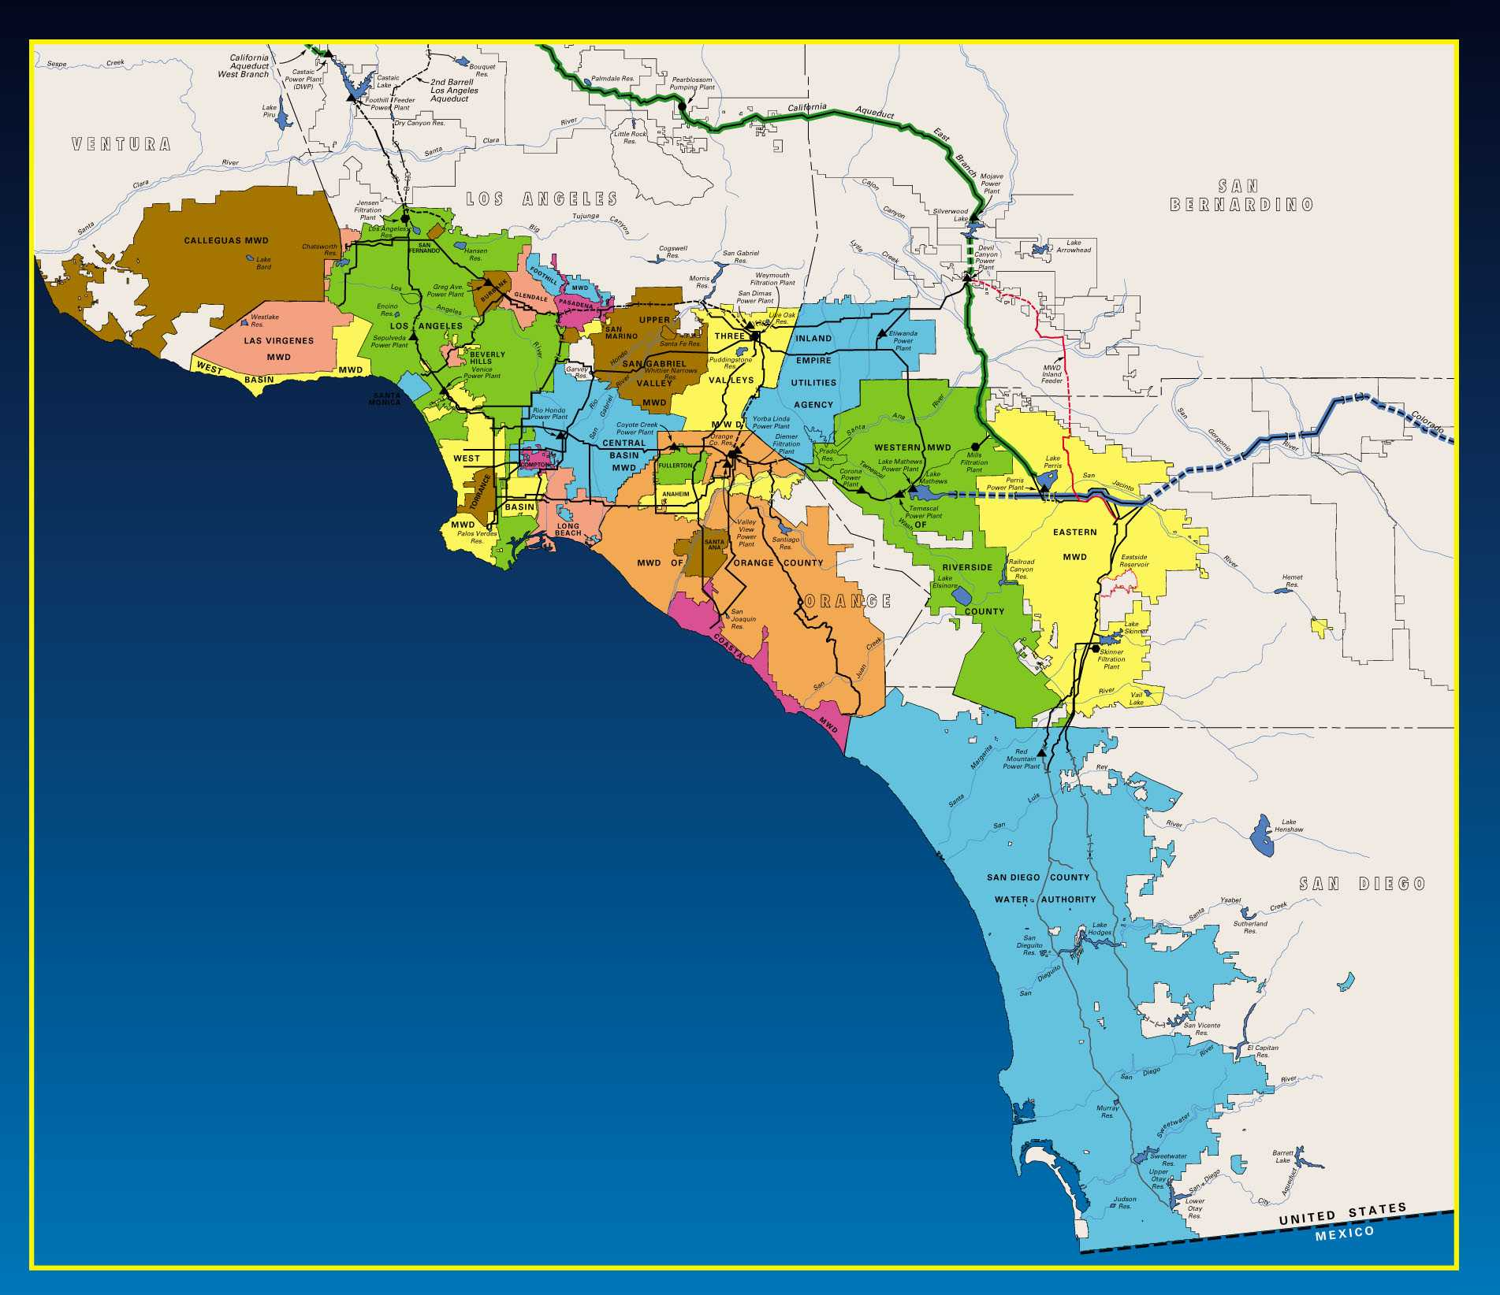
Metropolitan Water District
Water Wholesaler
26 Members Agencies
5,200 square miles
19 million people
$1 trillion regional economy
4 million acre-foot average water demand

Slide 4
Northern California Runoff
18.26 MAF
Notes:
Impacts of Dry Hydrology
What you see is what you get
Limited reservoir storage increases
SWP Table A allocation increases will be based on observed rather than forecasted runoff
Any increases would be late in the year
Water in Oroville may be needed to meet upstream and in-Delta regulatory requirements
Export opportunities may be limited
Impacts felt across the State
Transfer supplies may be at risk

Slide 5
April 1st Historical Snowpack
Northern Sierra
Last 10 Years
7 Lowest Years
Average
‘07 ‘13 ‘90 ‘88 ‘77 ‘14 ‘15

Slide 6
Phillips Snow Course April 1, 2010
Notes:
106% of normal

Slide 7
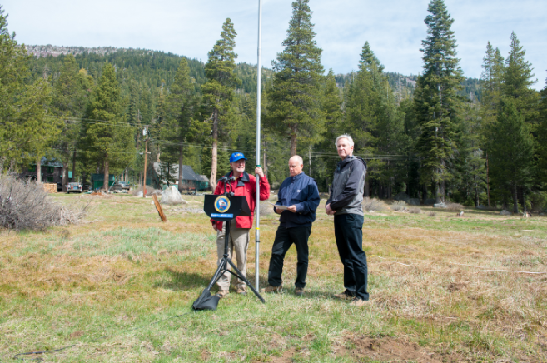
Phillips Snow Course April 1, 2015

Slide 8
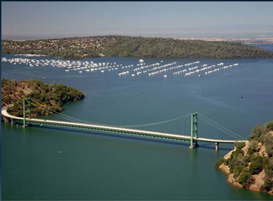
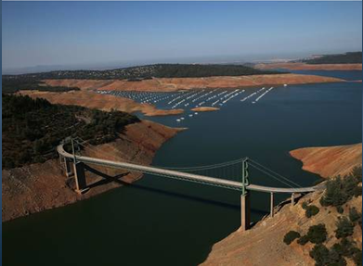
Notes:
The Green Bridge of Lake Oroville

Slide 9
Upper Colorado River Basin Runoff
Upper Colorado River Basin Still in a Long-term Drought
10.88 MAF

Slide 10
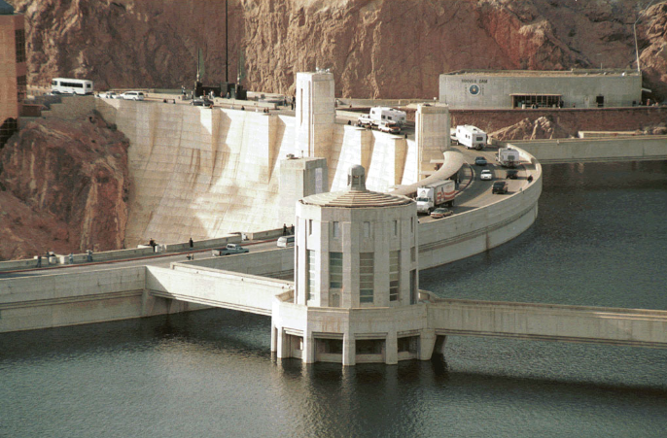
Lake Mead
Notes:
Lake Mead full - 1998

Slide 11
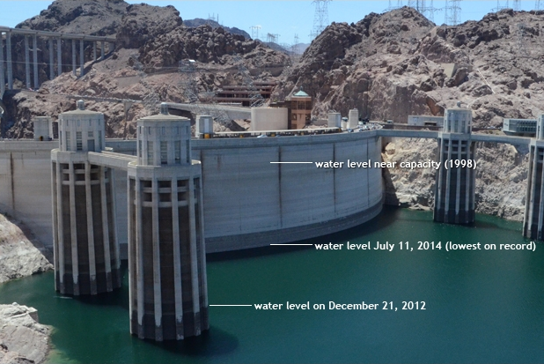
Lake Mead
Notes:
Today we are 5 feet below this water level shown for July 11 2014. This is the most recent photo I have.

Slide 12
MWD Water Supply Strategy Average Year Water Supply – 1990 vs. 2035
Conservation & Recycling
(7%)
Colorado (14%)
Colorado (27%)
Conservation & Recycling
(33%)
Local Supply (34%)
State WP (22%)
State WP (33%)
Local Supply (31%)
1990 – 41% Local
2035 – 64% Local
Heavy dependence on
imported supplies
Emphasis on conservation, recycling, & local supplies

Slide 13
Demands Remain Flat Even As Population Grew By 5 Million

Slide 14
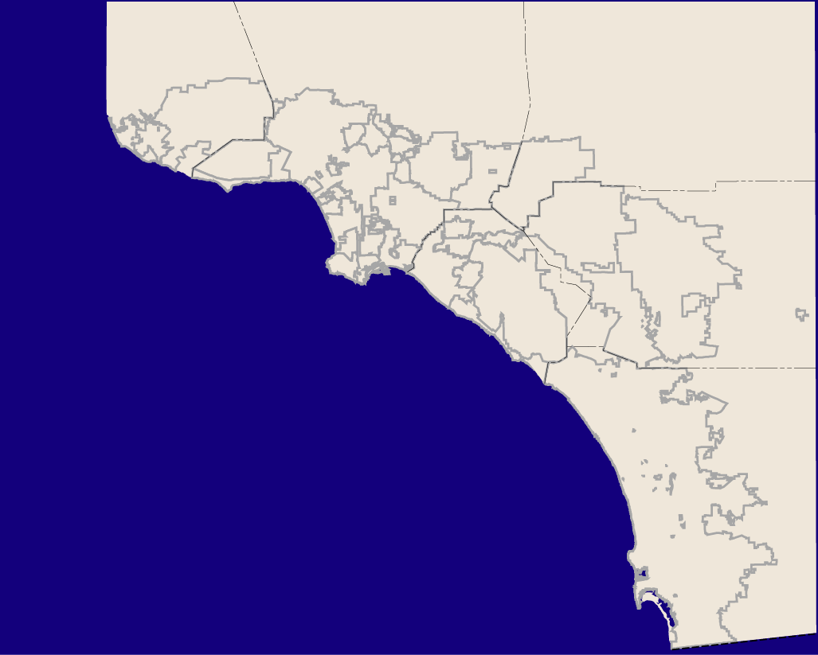
Metropolitan Water District of Southern California
Local Resources Program
 | Program | Number of Projects | Contract Yield (AFY) | Deliveries to Date (AF) | Incentives to Date ($M)
 | Recycling | 75 | 306,000 | 2,160,000 | 360
 | Groundwater Recovery | 24 | 113,000 | 749,000 | 127
 | Total | 99 | 419,000 | 2,909,000 | 487
Notes:
Metropolitan’s Local Resources Program has supported water recycling and groundwater recovery since the 1980’s.
This slide shows the location of the 99 projects located throughout Metropolitan’s service area with a contract yield of over 400,000 acre-feet with about three-fourths being recycled water.
The program has generated nearly three million acre-feet to date and Metropolitan has spent nearly half a billion dollars to date on the LRP.

Slide 15
Metropolitan’s Storage Capacity
13x Increase in Capacity

Slide 16
Capture Wet Year Supplies To Buffer Drought Impacts
1.1
*Estimated actual storage balances, subject to change.
Notes:
Message, we are prepared for a dry year!
2013 ending balance - 2.353 MAF, rounds to 2.4 MAF

Slide 17
